Slide 1
Information Session Presentation

Slide 2
Overview
The MbeleNaBiz Business Plan Competition (“MbeleNaBiz”) is an initiative of the Government of Kenya, implemented by the Micro and Small Enterprises Authority (MSEA) and the Ministry of Public Service, Youth and Gender Affairs (MPYG), with support from the World Bank. KPMG has been contracted to manage the Competition
MbeleNaBiz aims to expand promising youth-led enterprises by providing them with grant funding and in some cases business plan training.
Objective
MbeleNaBiz seeks to create jobs and increase income for young Kenyans.
750 successful applicants will receive:
Some select applicants will receive training in business plan preparation
Financial awards of
either Ksh 900,000
or Ksh 3,600,000

Slide 3
What is MbeleNaBiz looking for?
High potential businesses that will create employment for young Kenyans
CREATE JOBS FOR YOUTH
Businesses that harness the creativity of young people in Kenya
Promising businesses that demonstrate commercial viability
SCALABLE
YOUTH LED
Businesses (both new and existing) must operate in Kenya

Slide 4
Who can apply for MbeleNaBiz?
AGE
NATIONALITY
LEVEL OF EDUCATION
GEOGRAPHY
The applicant and majority (at least 70%) of the shareholders must be aged between 18-35 at the date of application
The applicant must be a Kenyan national. Kenyans living abroad can apply but will need to demonstrate that they will live and operate the business in Kenya
The applicant must have completed a minimum Form 4 qualification or equivalent
The business must operate in Kenya

Slide 5
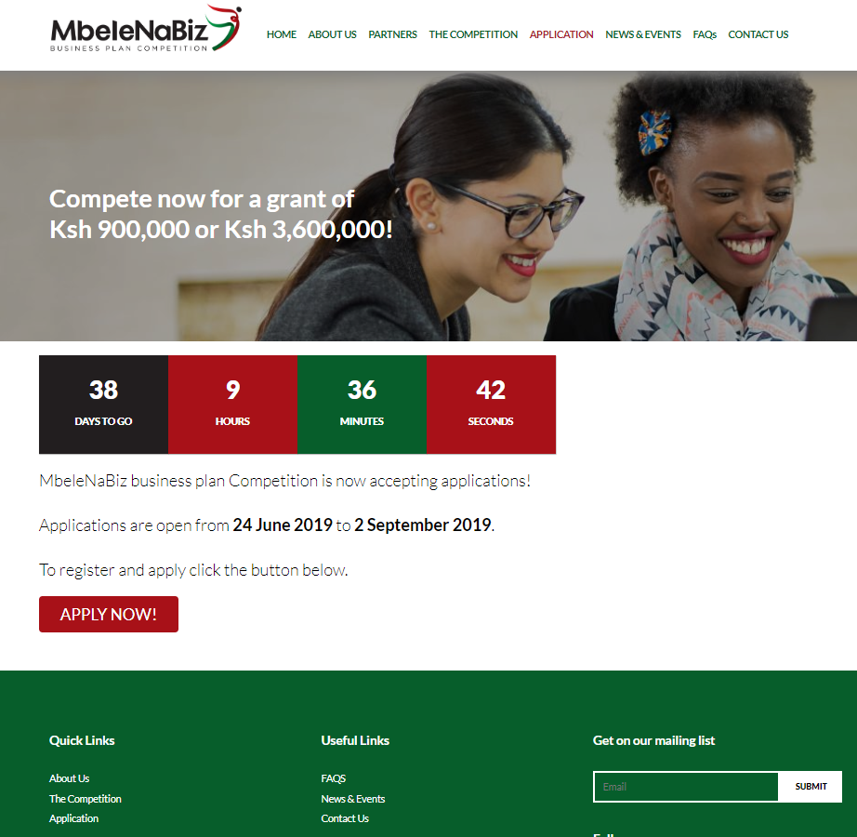
How do you apply for MbeleNaBiz?
ONLINE
PAPER APPLICATIONS
Visit www.mbelenabiz.go.ke and apply through the competition registration link
For those without access to the internet or a computer, it is possible to submit a paper application*
Paper applications can be collected from and submitted to:
*County Youth Directors
across all counties
*Please note we strongly encourage submission of applications online

Slide 6
Online Application Process- Step by Step
In order to apply, ensure your business meets the eligibility criteria for the competition.
Read through all the information on the website; www.mbelenabiz.go.ke
Click on ‘Apply Now’ to access the online application portal, register and apply.
Read and accept the terms and conditions of the competition.
Fill in all the sections on the application form, ensuring you do not exceed the character limit.
Fill in all the business details accurately (Please note incorrect details may lead to ineligibility)
Once validation is 100%, save & close the application and then click ‘submit application’ on the right corner of the summary page.
*Upon submission, applicants will receive a Reference Number.
*An automated e-mail communication will be sent to each applicant acknowledging receipt of submitted applications and informing them of the Reference Number allocated to their applications.
*If you have any questions regarding your application, questions can be directed to: info@mbelenabiz.go.ke or you can call: 0709 576 464
The deadline for submitting applications is 23:59 pm East African Time on 2 September 2019 .

Slide 7
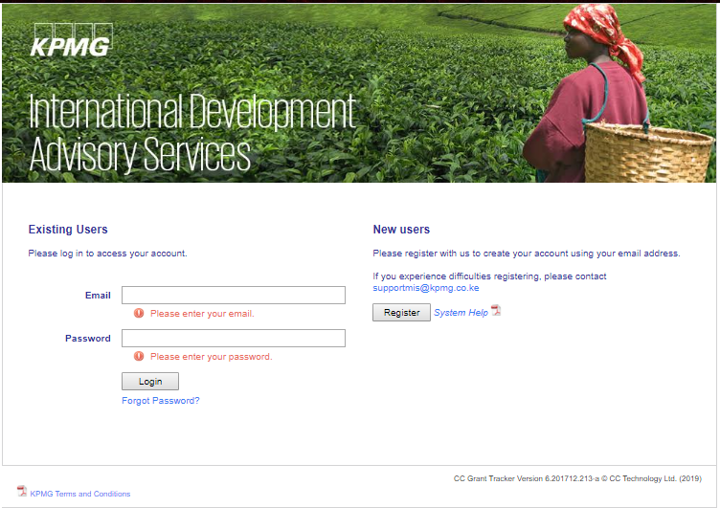
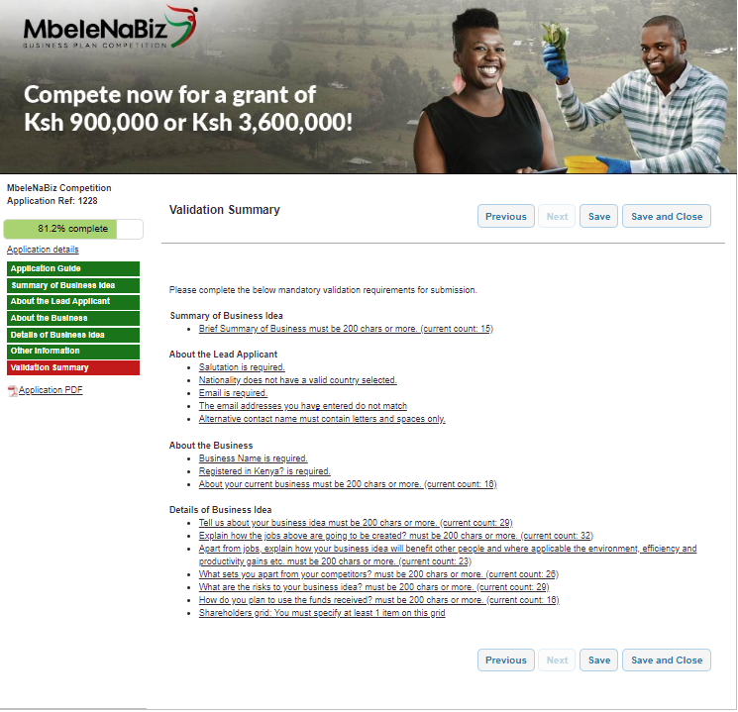
Application Portal

Slide 8
Application Timeline
Applications will be reviewed by KPMG and an independent panel of judges who are required to sign confidentiality agreements to ensure the Business Ideas are kept safe and are not shared with any outside parties or with other applicants.

Slide 9
Frequently Asked Questions
Can I apply for MbeleNaBiz Competition as an individual or as a group?
Can I apply for the competition if I only have a new innovative business idea that is not operational?
How many applications can one individual submit?
Is it a must for the budget of the project to be within Kshs. 900,000 to Kshs. 3,600,000?
Is the amount awarded a grant or loan?
How do I qualify to submit this application in this competition?
How do I submit the application once I complete all the sections?
When will I receive feedback after submitting my application?
How will you ensure that my innovative business idea is kept confidential?
Can I still apply for MbeleNaBiz if I was a KYEOP beneficiary?

Slide 10
MbeleNaBiz Partners

Slide 11
QUESTIONS?

Slide 12
@BizMbele
MbeleNaBiz
MbeleNaBiz
Mbele_Na_Biz
Phone Number: 0709576464 / Email: info@mbelenabiz.go.ke /Website: www.mbelenabiz.go.ke

